Slide 1

Team: SolveRx
Food and Shelter Service during the Pandemic

Slide 2
TEAM
Drishti Kishore
Tanisha Banik
Siddhi Vinayak Tripathi
Venkatesh Chakrabarty
Theme: Healthcare

Slide 3
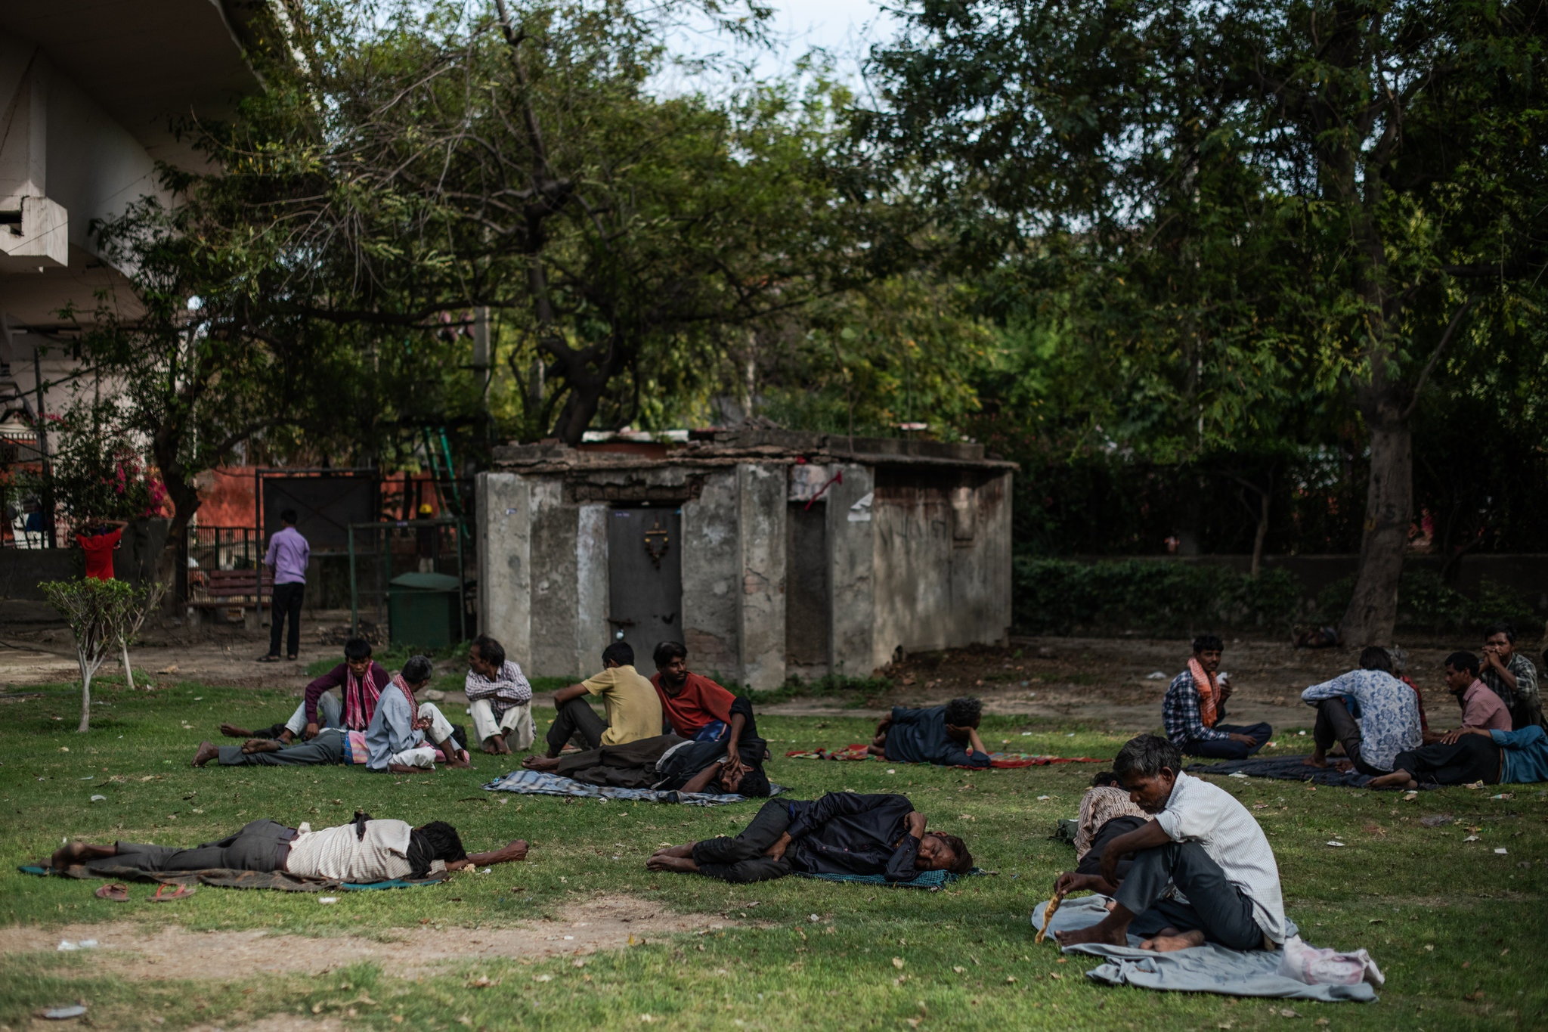
PROBLEM STATEMENT
Due to COVID-19, a huge number of people in our country are on the streets now with no food and shelter. Most of these people are labourers who traveled far away from their homes for work. They lived and worked at the site of work and earned their day-to-day living. But since businesses have closed due to the lockdown, they neither have a place to live nor money for food. And since the Union Government has banned interstate travel they are stuck with nowhere to go. This ban has also led to a shortage of raw food materials. Even though food(raw/cooked) related transportation is not prohibited by the Governmnet, people are restricting their travel in fear of coming in contact of an infected. Even though real estate owners and hoteliers are providing empty rooms for isolating the infected only come forward to provide such temporary housing for the needy. And due to rise in prices, food and other commodities are becoming less affordable.

Slide 4

SOLUTION METHOD
This solution is intended for the homeless and peniless on the streets.
Shelter Shortage - Can be solved by providing a temporary shelter space keeping in mind the current physical distancing regulations.
Food Shortage- Can be solved by fulfilling shortage of raw ingredients and cooked food and managing their delivery.

Slide 5
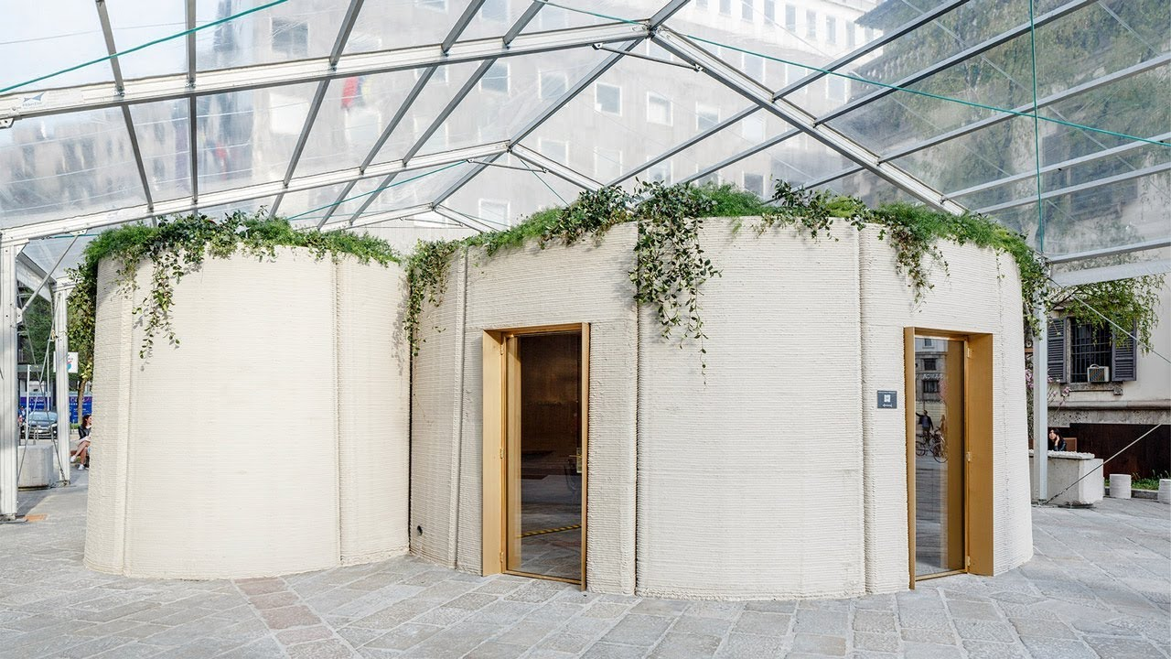
SOLUTION IDEA
SolveRx Food and Shelter ServiceA service which provides shelter and food to the needy. He/she can contact the service via Online/Offline mode and will be directed to the nearest shelter.
Shelter solution: Connecting the real estate owners, hoteliers, etc. to a service where they can put their properties up for the needy to stay temporarily. But since these are not in a large enough number to accomodate all of the homeless, new residential buildings are needed which can be built easily and quickly and can be done away with the same ease and speed if not esier and faster. 3D Printing small 1-3 room accomodocations(according to the size of the family)can solve this very easily and quickly. Can also be repurposed as isolation wards for those testing positive for COVID-19.
Food solution: Shortage of raw food materials can be quickly solved with the help of vertical farming. inside the cities which eliminates the issue of raw crops scarcity due to inter-state ttravel bans. It also saves time since crops grow faster and no need for transportation. In fact, other than growing large amounts of crops in controlled spaces for the majority, we propose giving a mini version in the shelters so that they can grow and feed themselves on their own.

Slide 6
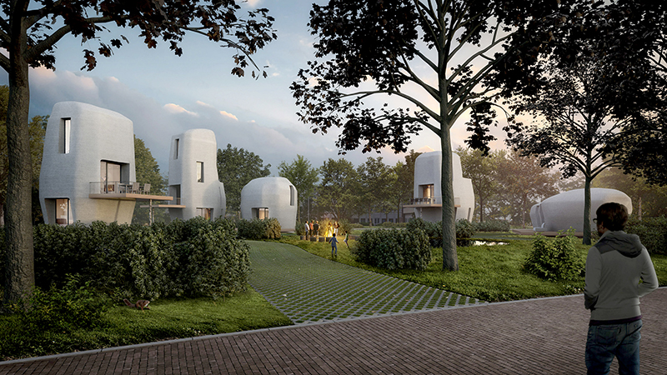
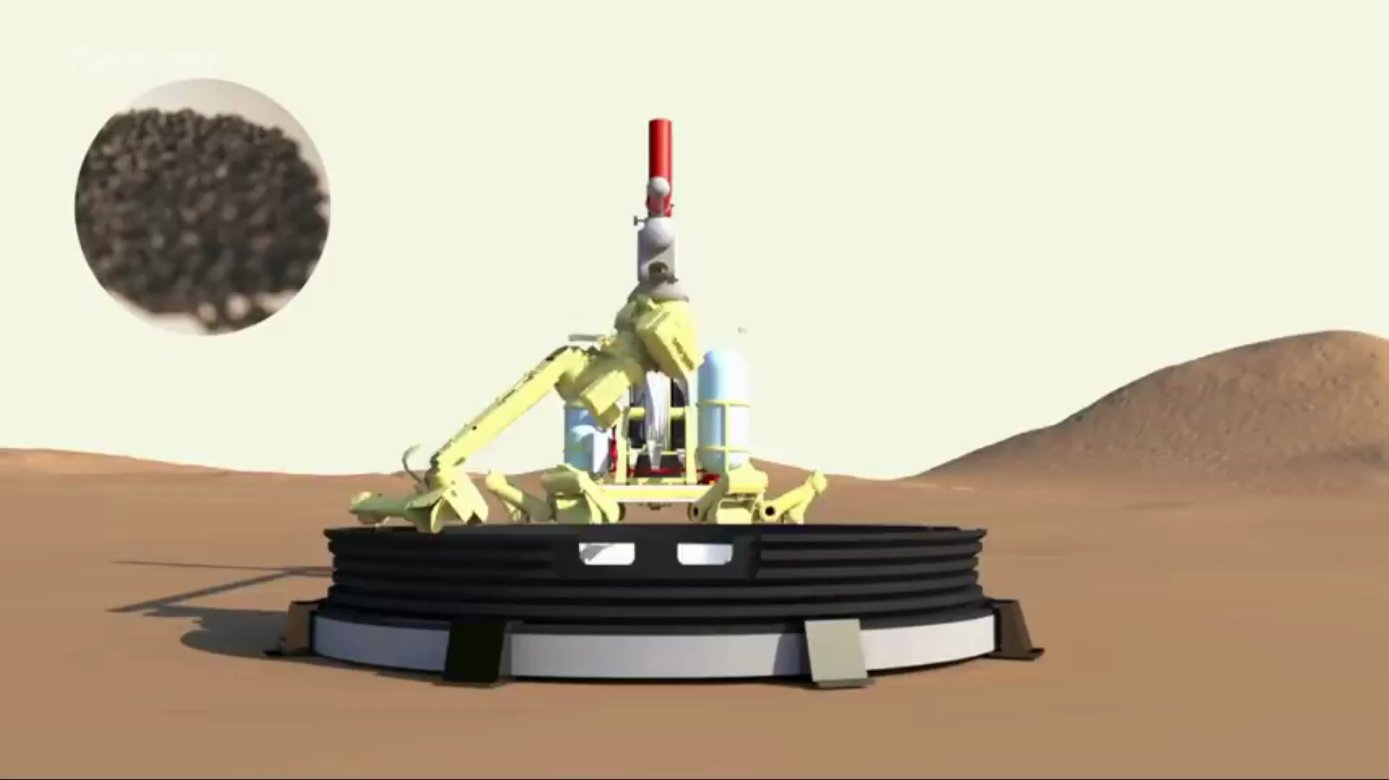
SOLUTION
3D Printed shelters
Print small shelters for temporary accomodation
Material: Biopolymers
At least 50% stronger than cement.
Completely recyclable-can be easily removed after usage.
Eco-friendly.
Does not need water.
Small shelters 3m high and 3meters squared can easily be built in 20-30 minutes.

Slide 7
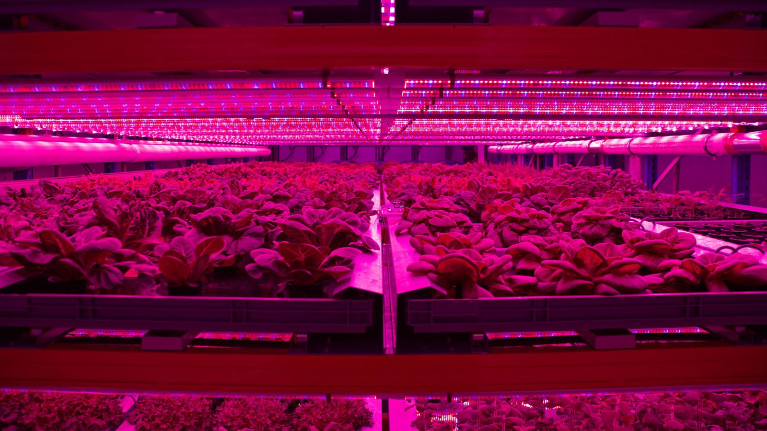
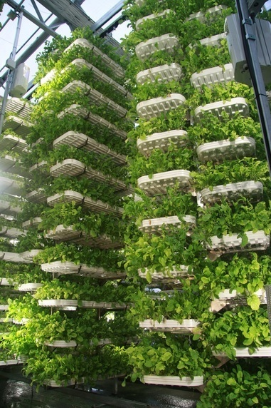
SOLUTION (Contd.)
Vertical Farms in cities
Includes:
Controlled environment
agriculture
Hydroponics
Aquaponics
Aeroponics
No need of soil.
No weeding required.
Produce crops or fish.
Large variety of produce.
Crops grow faster than conventional farming methods.
No need of insecticides, pesticides or other agrochemicals.
Requires 1/10th of surface area for same quantity of profduce.
Year round yeild without any effect of climatic changes or weather conditions, on crops.
Water can be reused mutiple number of times i.e. less water requirement.

Slide 8
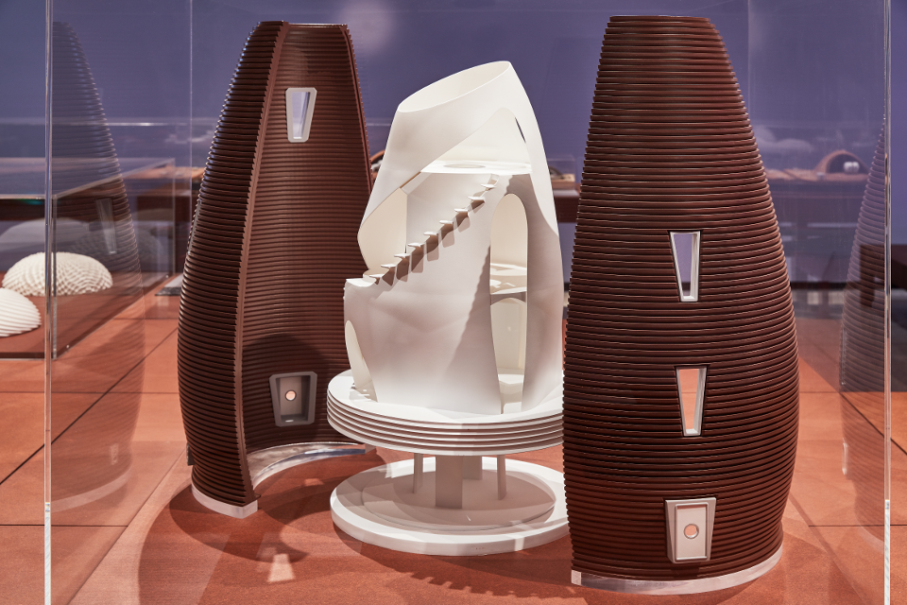
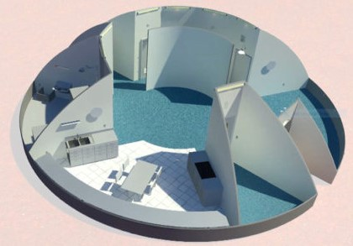
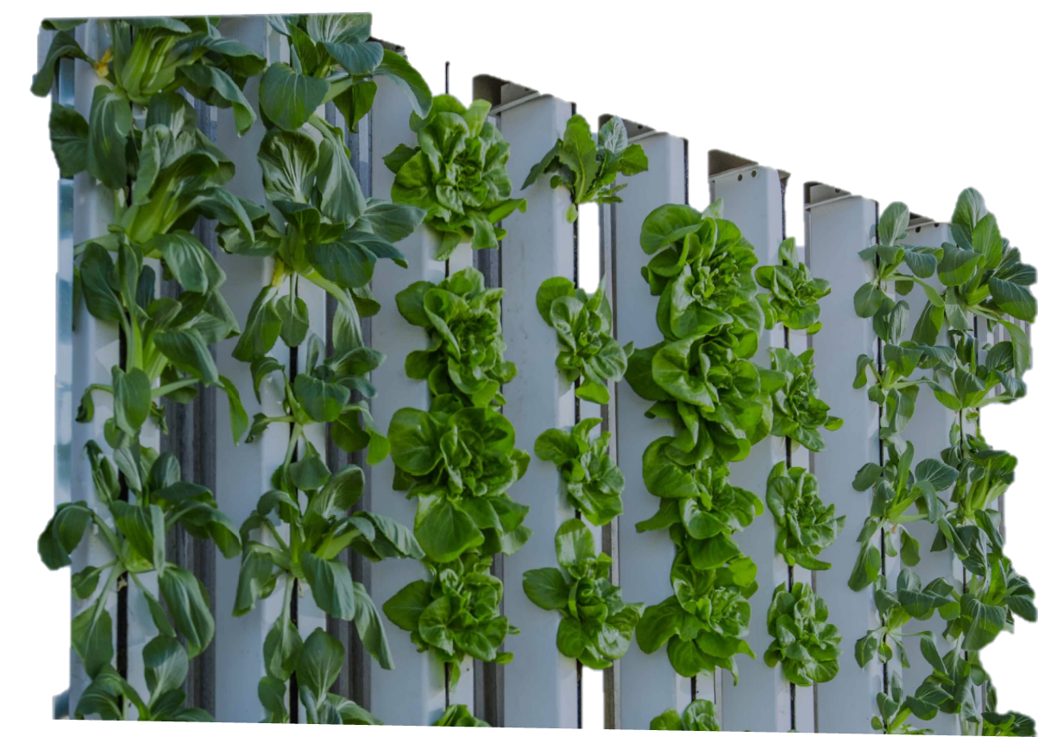
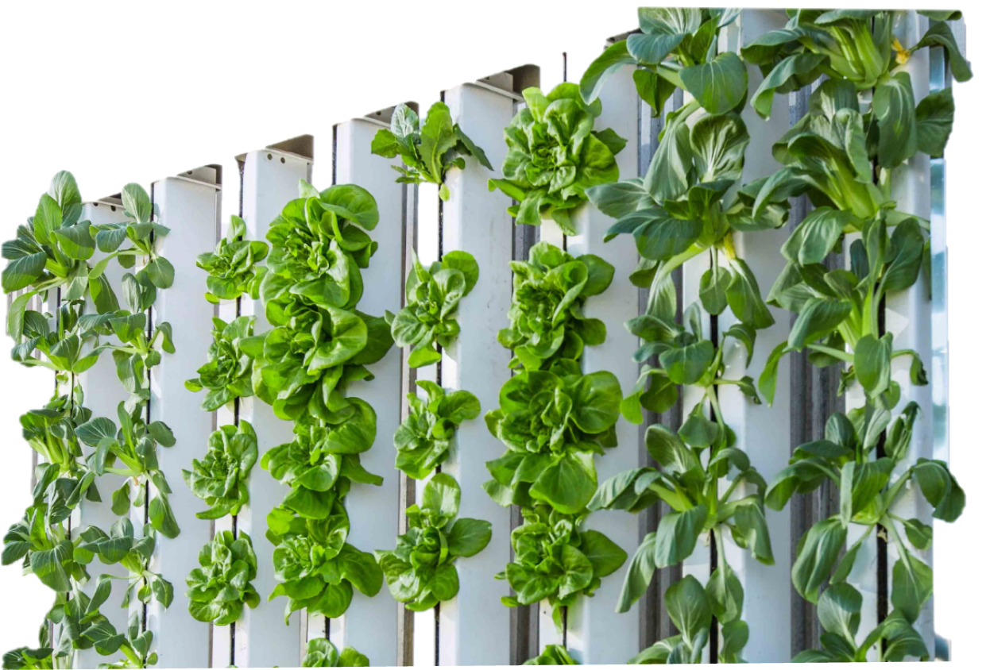
ARCHITECTURE DIAGRAM
Wash room
Bed room
Entrance
3D Printed shelters
Can be custom designed for single person use or families while making making max. usage of space available.
Taller consunstructions can have more floors completely isolated from each other.
Vertical Farming can be carried out in an isolated section of the house.
Solar panels for minimal electricity supply.
Kitchen
Isolated controlled room for vertical farming

Slide 9
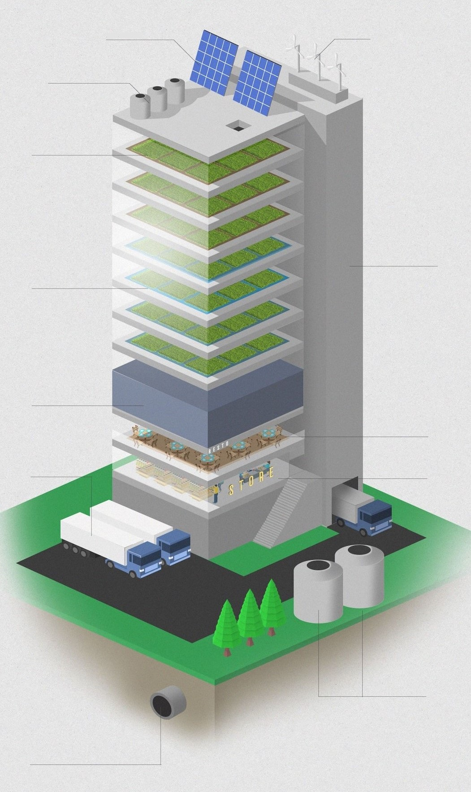
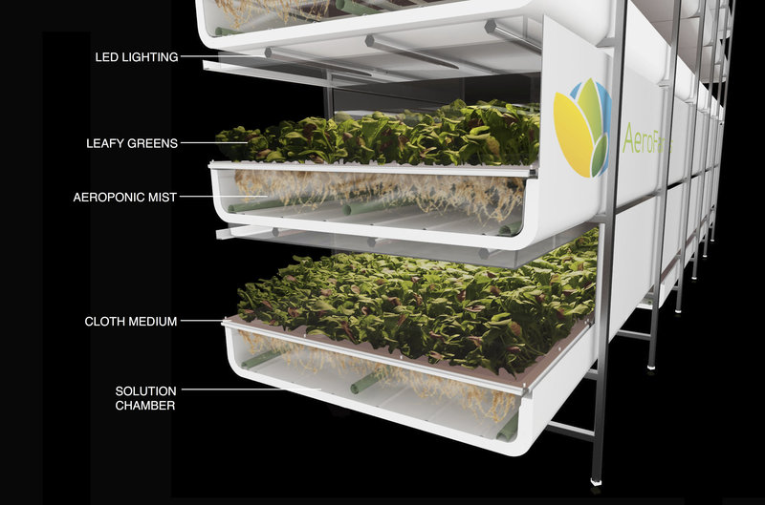
Solar Cells
Wind Turbine
ARCHITECTURE DIAGRAM (Contd.)
Structure of Vertical Farm & Food Service
Rainwater Collection
Aeroponics
Drip irrigation
Hydroponics
Aquaponics &
Aquaculture
Restaunrant
Shipping Bay
Grocery
Biodigesters
Urban wastewter reclamation

Slide 10
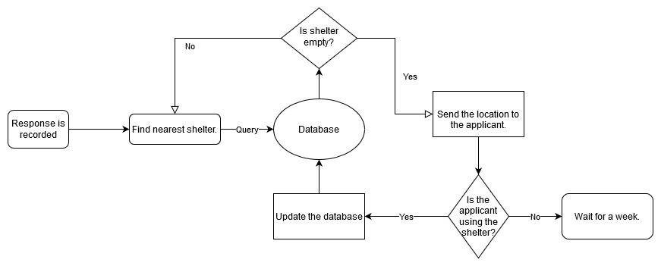
ARCHITECTURE DIAGRAM (Contd.)
Flow Chart for the registration process of customer

Slide 11
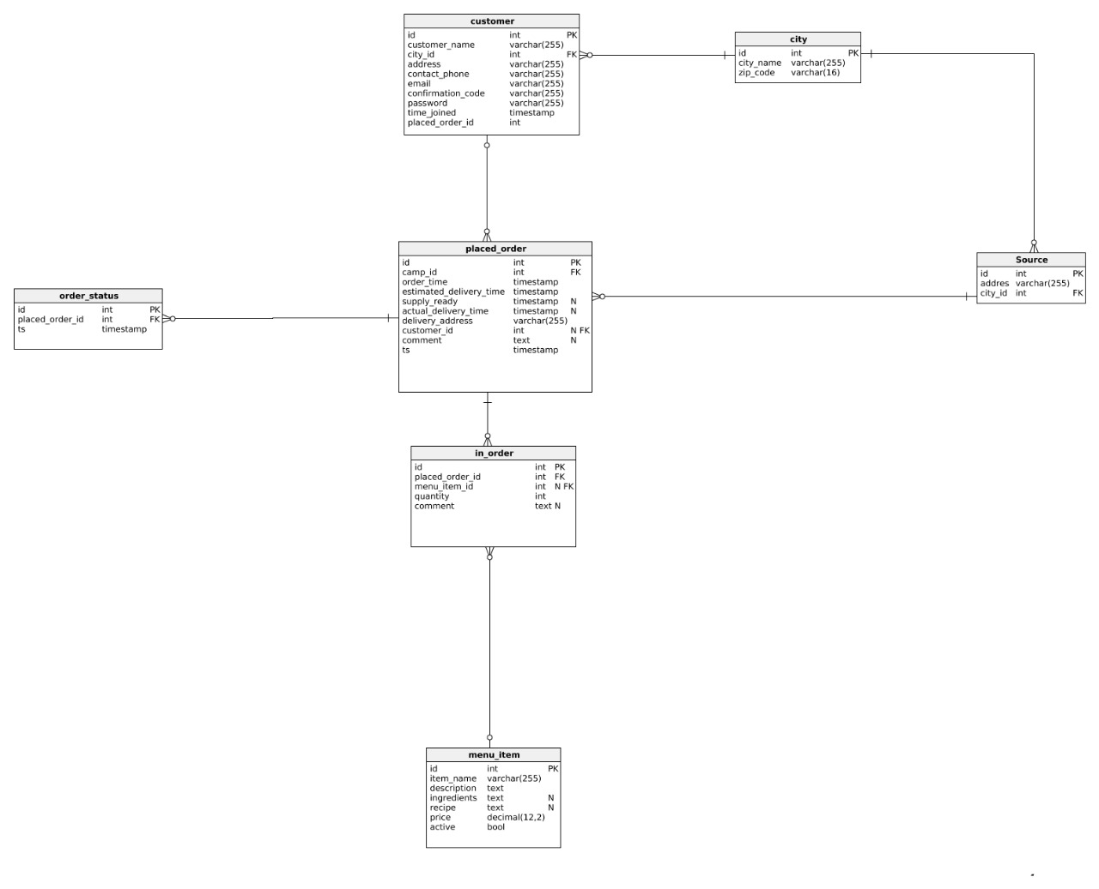
ARCHITECTURE DIAGRAM Contd.
ER Diagram for the food and shelter service

Slide 12
SolveRx Shelter and Food Service
BUSINESS MODEL
To find shelter one must visit our website for online registration or send a message/missed call on our helpline number and the customer care will get back to the customer based on the customer's choice of medium, i.e., in case of text message a format will be sent back to the customer according to which he can send his personal details for registration and in case of voice call the customer care would register him/her according to the details given and his detaols are stored in the database.
After the registration process, customer's location is known either by gps, text or voice call with the customer care.
Accordingly, the nearest available shelter is searched and allotted to the customer and details sent.
The shelters other than the ones temporarily donated would be constructed through 3D printing and are completely recycleable.
The shelters would be built to accomodate individuals as well as families accordingly. And each registered customer is isolated from other customers in different shelter homes keeping in view of physical distancing regulations. These can also be used as self quarantine wards if they test positive for COVID-19.
They will be accomodated with in-house vertical farming chambers where they can grow their own food.
Other than that, our food service would produce crops, fish and cooked food for conumption of residents with shortage.
They can get a source of income for the time being if they are willing to work at the vertical farm.
Thus, our business model completely solves the problem of providing food and shelter during the pandemic.
Our model is better that the other companies providing cooked food because they cannot solve the problem of shortage of raw ingredients while keeping it cost effective while our model ensures food at low prices because we don't need to spend on buying raw materials, transportation, irrigation, insectisides and pesticides and many other expenditures making it cost effective and more nuttritious since they are freshly available for consumption.

Slide 13
THANK YOU
Team: SolveRx

